Slide 1
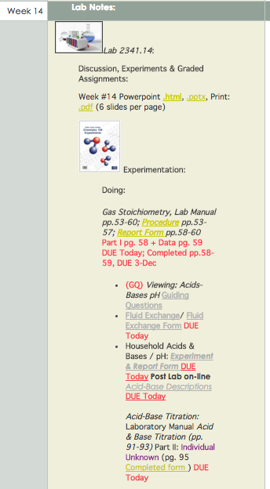
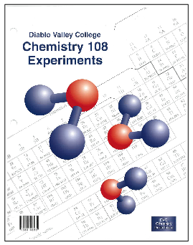
Chem 108: Lab
Week 16
Sign in
Pick up papers
& handout
Experiment:
Synthesis of Aspirin
pp.87-91

Slide 2
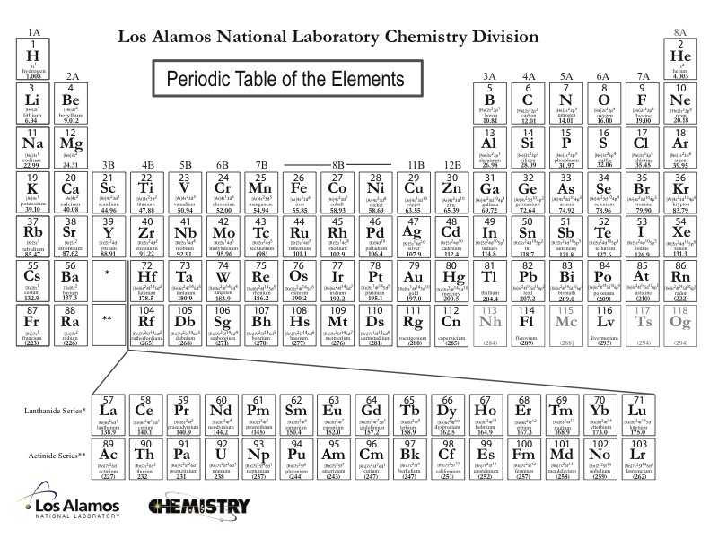
Elemental building blocks for all organic molecules
Notes:
Discipline-Based Education Research: Understanding and
Improving Learning in Undergraduate Science and Engineering
Susan R. Singer, Natalie R. Nielsen, and Heidi A. Schweingruber, Editors
ISBN 978-0-309-25411-3 | DOI 10.17226/13362 2012
Effective instruction involves a range of
approaches, including making lectures more interactive, having students
work in groups, and incorporating authentic problems and activities.
Students who go on to have successful careers in science or engineering
must be problem solvers, skilled in quantitative reasoning and modeling,
effective at communication and cross-disciplinary collaboration, and cognizant
of relationships between science and society (Brewer and Smith,
2011). Students who do not pursue these careers need to understand science
and engineering to serve in their roles as citizens, consumers, and leaders
of business and government who need to make wise science-informed
decisions in their personal and professional lives. Choosing healthcare for
one’s children, buying a car, voting about land-use regulations, or retrofitting
one’s house or business to be more earthquake-resistant are but a few
of the decisions that today’s undergraduates may face. Their decisions on
these and other issues will be based, in part, on their confidence in the
methods of science and engineering and their understanding of the findings
of science and engineering.
The importance of science and engineering in preparing the technical
workforce and a science-literate citizenry has drawn increased attention to
the quality of undergraduate science and engineering education and how it
can be improved. There are persistent concerns that undergraduate science
and engineering courses are not providing students with high-quality learning
experiences, nor are they attracting and retaining students in science
and engineering fields (President’s Council of Advisors on Science and Technology,
2012). Colleges and universities also face the challenge of serving
an increasingly socially, economically, and ethnically diverse undergraduate
population entering college classrooms directly from high school, after a
military career or other life experiences, or from postsecondary educational
experiences at another institution. Sustained attention to motivating, engaging
and supporting the learning of all students who enter college science
and engineering classrooms is an imperative.

Slide 3
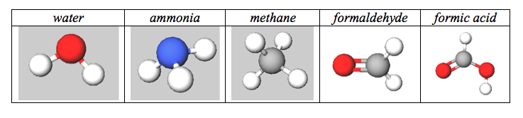
Shapes, Functions & Structural Analogies
Water, Ammonia, Methane
Plus C=O “carbonyls”
Organic Molecules
Notes:
1

Slide 4
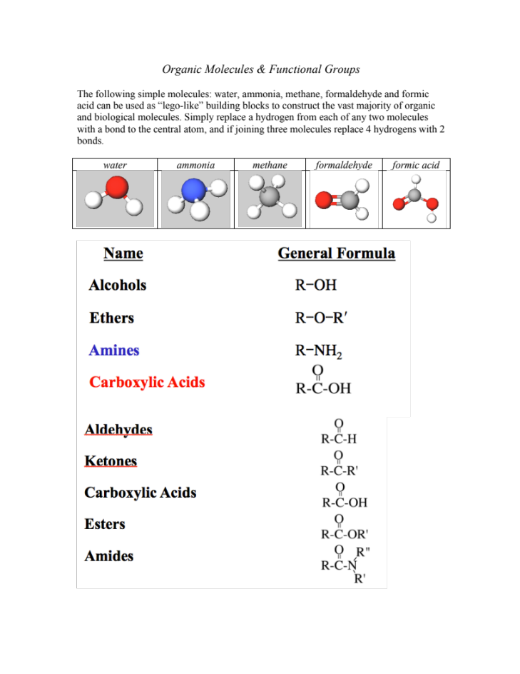
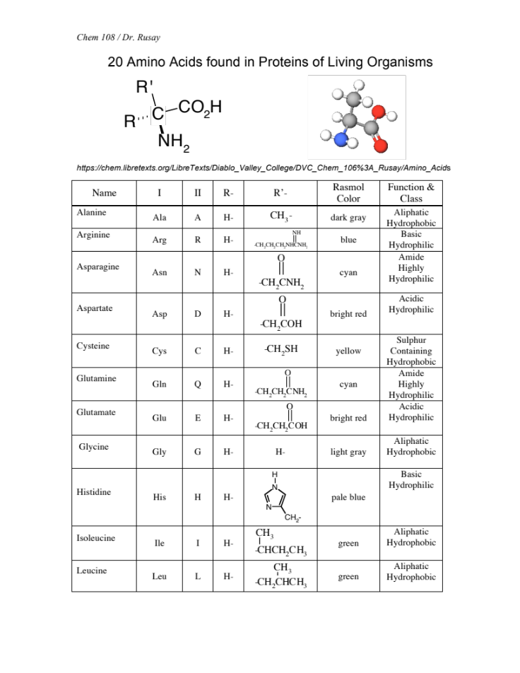
Functional Groups & Amino Acids

Slide 5
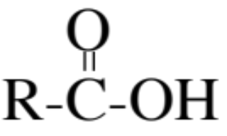
Organic Molecules
Common Functional Groups
Name General Formula
Alcohols R−ΟΗ
Ethers R−Ο−R′
Amines R−ΝΗ₂
Carboxylic Acids
R′− or R− represents any generic carbon atom bonded in the functional group

Slide 6
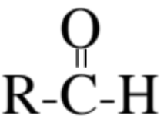
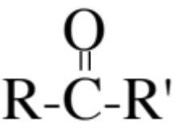
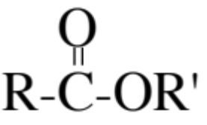
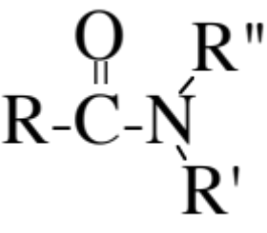
Organic Molecules
Common Functional Groups
Name General Formula
Aldehydes
Ketones
Carboxylic Acids
Esters
Amides
R′− or R− represents any generic carbon atom bonded in the functional group

Slide 7


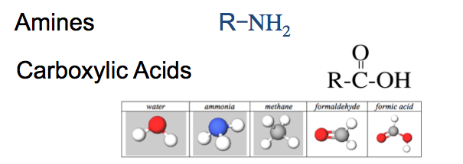
Amino acids: two functions, an acid & a base, in the same molecule
Functions
 | Alcohol | R−ΟΗ
 | Ether | R−Ο−R′
X | Amine | R−ΝΗ₂
 | Aldehyde
 | Ketone
X | Carboxylic Acid
 | Ester
 | Amide

Slide 8
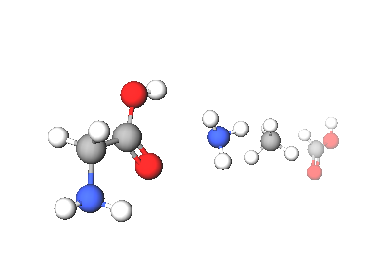
Amino Acids
Legos of Chemical Biology
Amino acids containing carbon, hydrogen, oxygen, and nitrogen, which resemble the following shapes & structural components
20 different amino acids are encoded in humans’ genetic code, which is archived in DNA.
Hundreds of amino acids link together with amide (peptide) bonds to form proteins, which provide the machinery and molecular backbone for the chemistry of life.
There are less than 20,000 total proteins produced from humans’ entire genome, each coded by a specific gene in DNA’s ~3 billion genetic bases.
http://chem.libretexts.org/LibreTexts/Diablo_Valley_College/DVC_Chem_106%3A_Rusay/Amino_Acids
Notes:
http://www.jbc.org/content/262/2/549.short
http://pdb101.rcsb.org/motm/54
http://www.rcsb.org/pdb/explore/jmol.do?structureId=1CFJ&bionumber=1

Slide 9
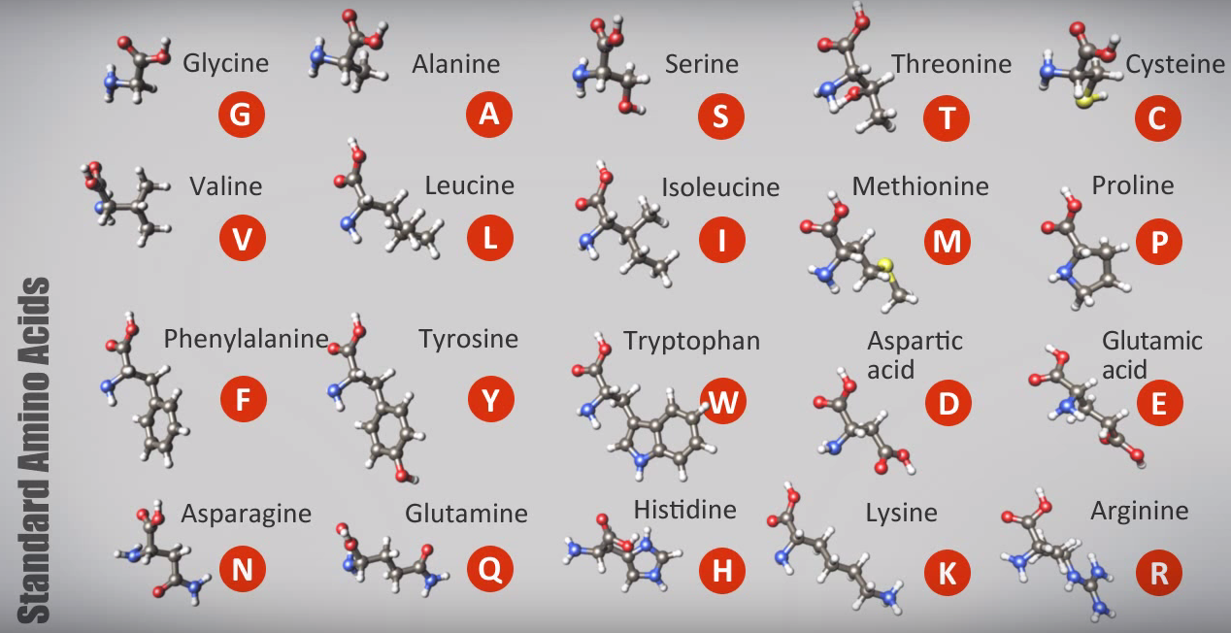
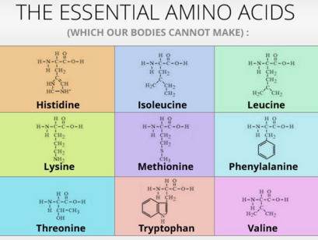
Amino Acids
Legos of Chemical Biology
All amino acids contain C, H, O, and N; two, C & M. also have sulfur.
http://chem.libretexts.org/LibreTexts/Diablo_Valley_College/DVC_Chem_106%3A_Rusay/Amino_Acids
Notes:
http://www.jbc.org/content/262/2/549.short
http://pdb101.rcsb.org/motm/54
http://www.rcsb.org/pdb/explore/jmol.do?structureId=1CFJ&bionumber=1

Slide 10
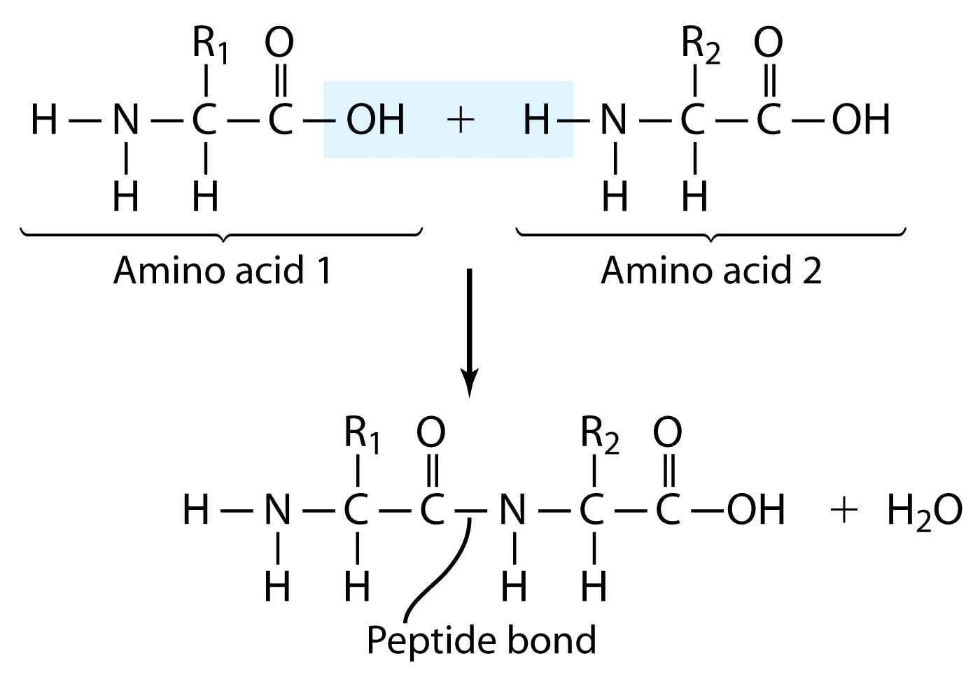
(Amide bond)

Slide 11
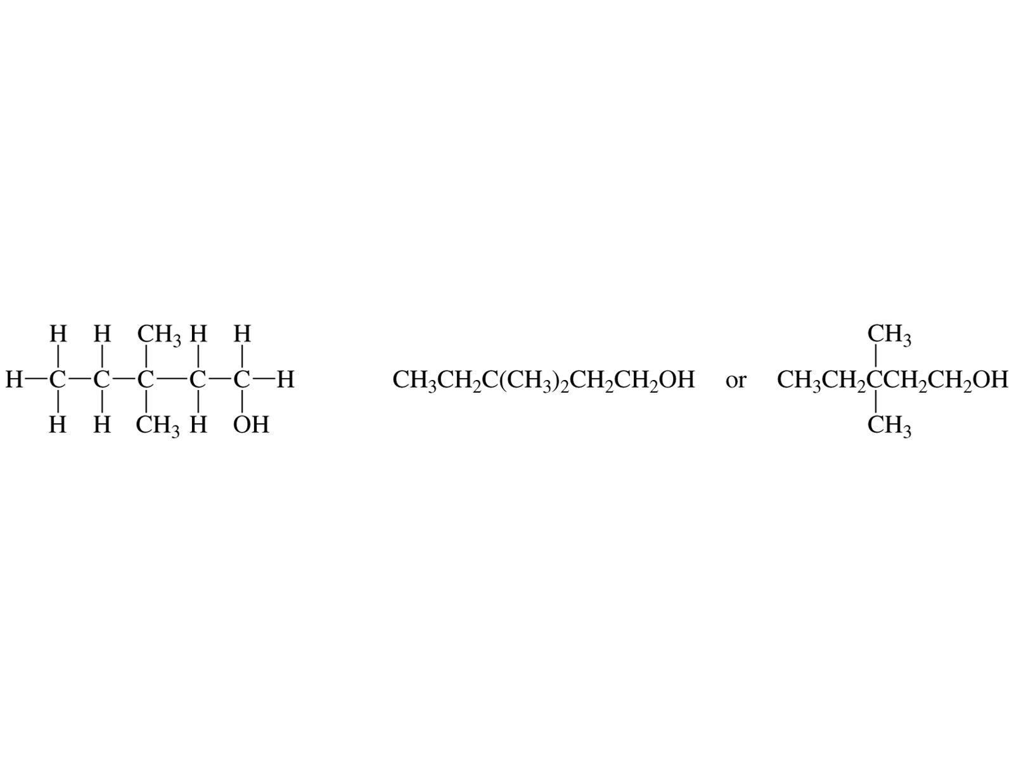
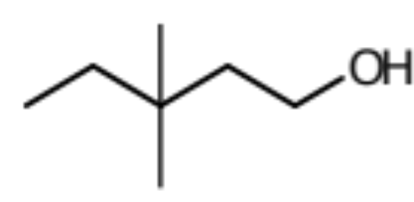
Representing Organic Molecules
Common Formulas & Drawings
Molecular formula:
C₇H₁₆O
Empirical Formula:
C₇H₁₆O
Condensed Structure:
Bond-Line Structure:
Organic Molecular Jeopardy
Team Selection

Slide 12
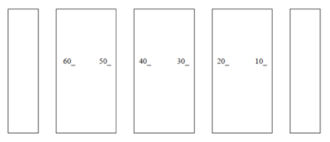
Organic Molecular Jeopardy
Team Selection
Pick a card & write your name on the card.
Go to the lab location noted on the map.
Front of Lab
A
B
C
D
E

Slide 13
Organic Molecular Jeopardy
Team Reporting
Select a Team Scribe:
Record the full names of your Team on the form Dr. R. provides and return it to him when complete.
Organic Molecular Jeopardy
TEAM:
 | Members
1
2
3
4
5

Slide 14
Organic Molecular Jeopardy
SCORING
There will be 7 questions (5pts each) embedded in the lab presentation; plus a final jeopardy question (15pts).
Dr. R will explain the rules. Lab bonus points will be awarded.
1st place: 25 pts
2nd place: 15 pts
3rd place: 10 pts
Other participant scoring: 5 pts

Slide 15
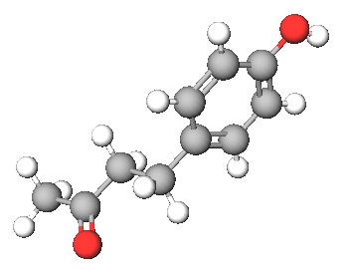
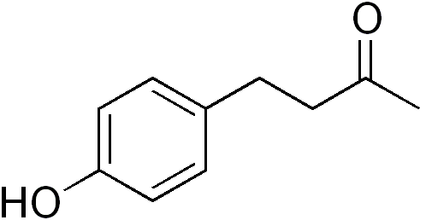

Organic Molecular Jeopardy
Common Formulas & Drawings
A compound that smells like fresh raspberries, is shown below. What is its molecular formula and molar mass?

Slide 16
Organic Molecular Jeopardy
Common Formulas & Drawings
Select the names of the 2 circled functions in the molecule.
 | Alcohol | R−ΟΗ
 | Ether | R−Ο−R′
 | Amine | R−ΝΗ₂
 | Aldehyde
 | Ketone
 | Carboxylic Acid
 | Ester
 | Amide

Slide 17
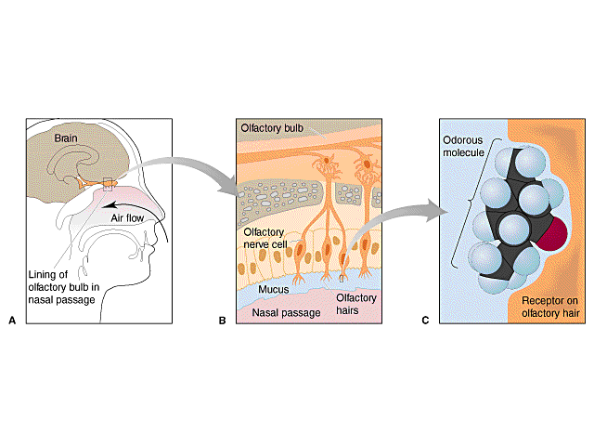

Detecting stuff we cannot see: the Sense of Smell
Models, Theories & Interactions
http://chemconnections.org/organic/chem226/Labs/Smell/smell-links.html
Structure-Odor Relationships
Karen J. Rossiter, Chem. Rev., 1996, 96, 3201-3240

Slide 18
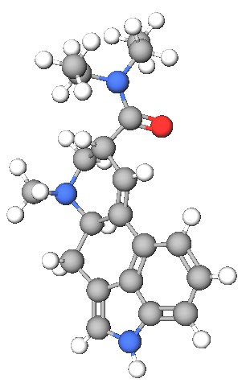
Organic Molecular Jeopardy
Common Formulas & Drawings
This molecule may interfere with the perception of the smell of raspberry. What two functions are in the structure?
Alcohol | R−ΟΗ
Ether | R−Ο−R′
Amine | R−ΝΗ₂ , R₂−ΝΗ, R₃−Ν
Aldehyde
Ketone
Carboxylic Acid
Ester
Amide

Slide 19
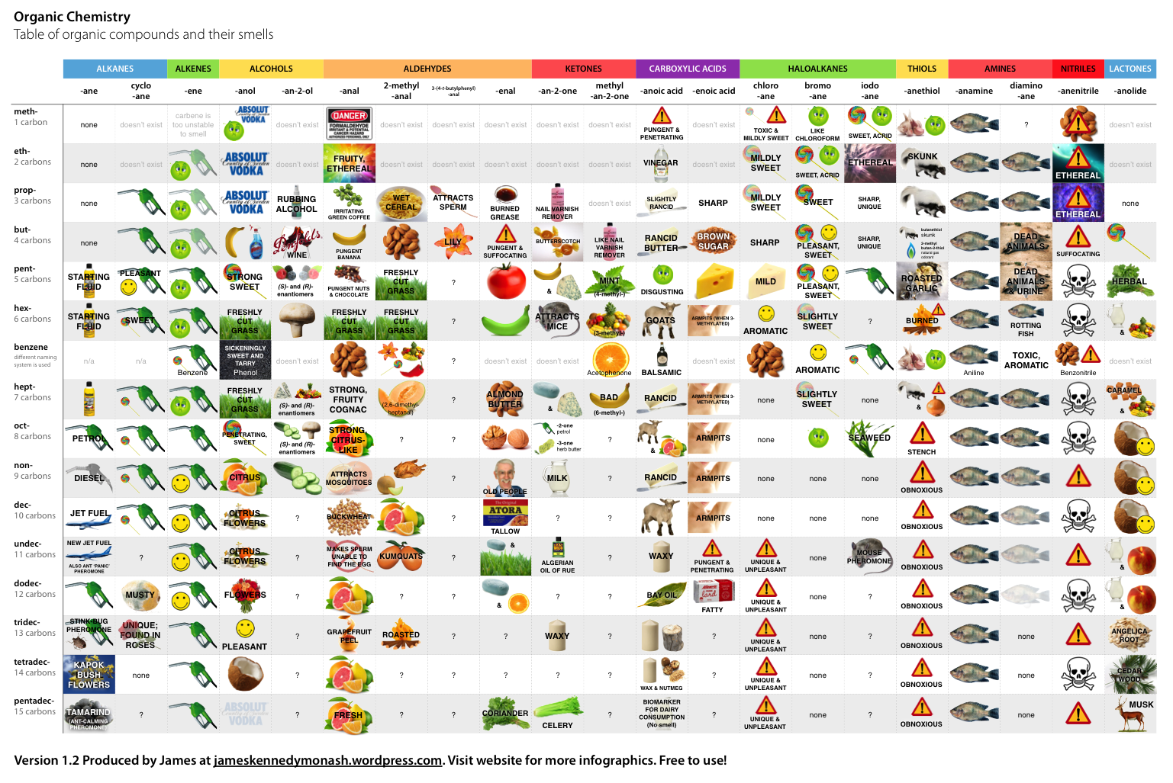
Organic Functions & Smell Receptors.
Notes:
Marcel Proust, was a French novelist, critic, and essayist best known for his monumental novel À la recherche du temps perdu (In Search of Lost Time; earlier rendered as Remembrance of Things Past), published in seven parts between 1913 and 1927. He is considered by critics and writers to be one of the most influential authors of the 20th century.[
1

Slide 20
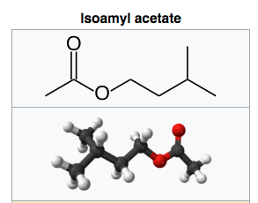
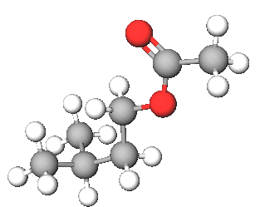
One molecule, One function: One Smell Receptor
Isoamyl acetate, also known as isopentyl acetate, is formed from isoamyl alcohol and acetic acid. It is a colorless liquid that is only slightly soluble in water, but very soluble in most organic solvents. Isoamyl acetate has a strong odor which is also described as similar to both banana and pear.[3] Banana oil may be either pure isoamyl acetate, or flavorings that are mixtures of isoamyl acetate, amyl acetate, and other flavors.
C₇H₁₄O₂
Notes:
Marcel Proust, was a French novelist, critic, and essayist best known for his monumental novel À la recherche du temps perdu (In Search of Lost Time; earlier rendered as Remembrance of Things Past), published in seven parts between 1913 and 1927. He is considered by critics and writers to be one of the most influential authors of the 20th century.[
1

Slide 21
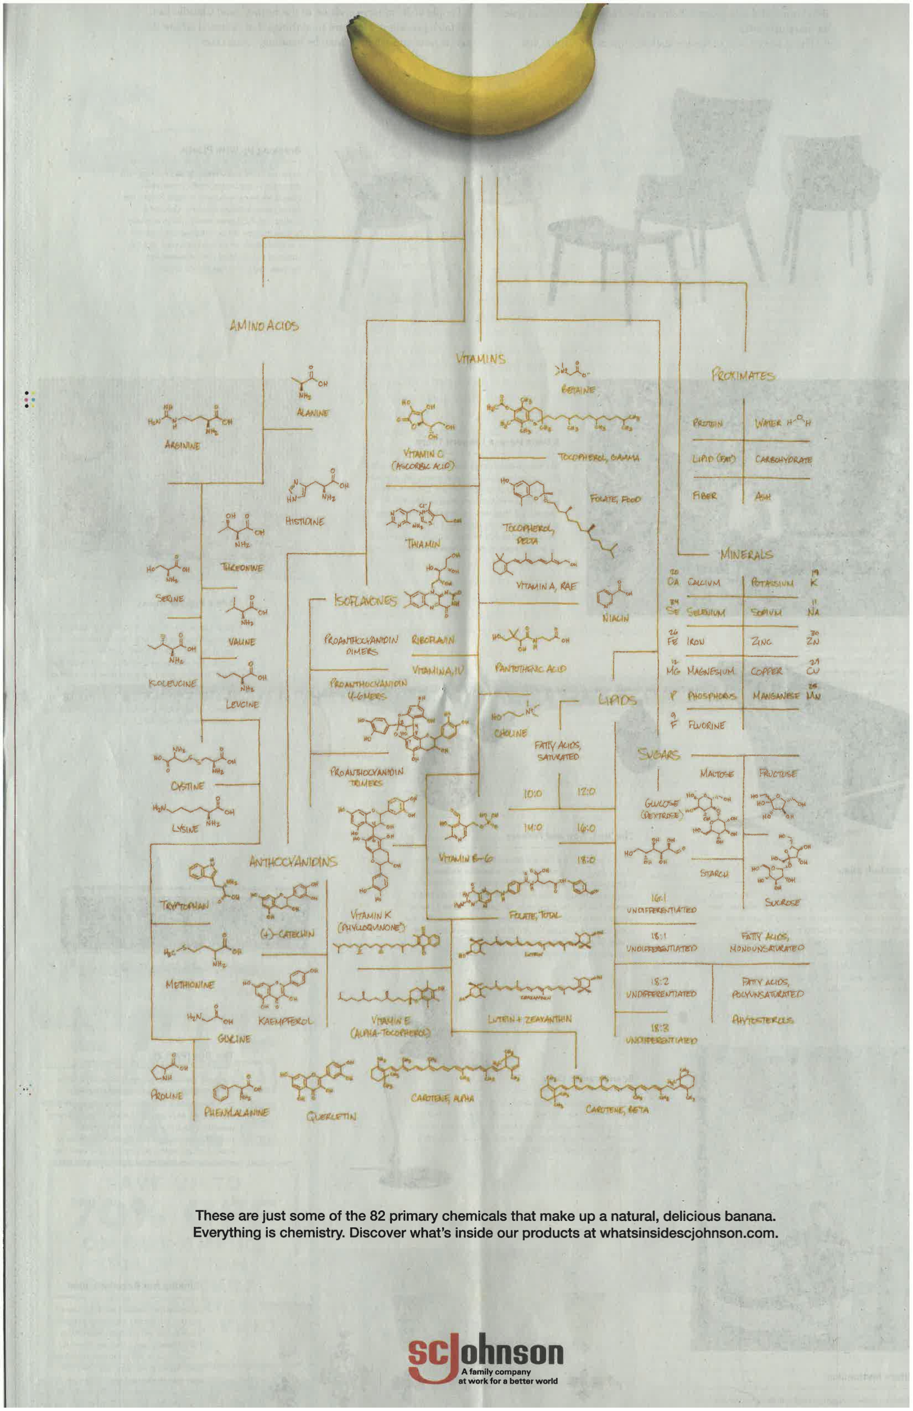
One molecule among 82 primary chemicals found in bananas:
C₇H₁₄O₂
Notes:
Marcel Proust, was a French novelist, critic, and essayist best known for his monumental novel À la recherche du temps perdu (In Search of Lost Time; earlier rendered as Remembrance of Things Past), published in seven parts between 1913 and 1927. He is considered by critics and writers to be one of the most influential authors of the 20th century.[
1

Slide 22
Organic Molecular Jeopardy
Common Formulas & Drawings
C₇H₁₄O₂
The function in isoamyl acetate’s structure is a(n):
Alcohol
Aldehyde
Ketone
Ester
Carboxylic Acid
Notes:
Marcel Proust, was a French novelist, critic, and essayist best known for his monumental novel À la recherche du temps perdu (In Search of Lost Time; earlier rendered as Remembrance of Things Past), published in seven parts between 1913 and 1927. He is considered by critics and writers to be one of the most influential authors of the 20th century.[
1

Slide 23
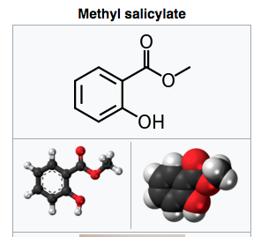
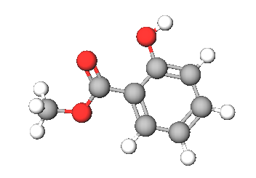
One molecule, two functions: One Smell Receptor
Methyl salicylate (oil of wintergreen or wintergreen oil) is naturally produced by many species of plants, particularly wintergreens. It is also synthetically produced, used as a fragrance, in foods and beverages, and in liniments.
C₈H₈O₃
Notes:
Methyl salicylate (oil of wintergreen or wintergreen oil) is an organic ester naturally produced by many species of plants, particularly wintergreens. It is also synthetically produced, used as a fragrance, in foods and beverages, and in liniments.
The compound methyl salicylate was first isolated (from the plant Gaultheria procumbens) in 1843 by the French chemist Auguste André Thomas Cahours (1813–1891), who identified it as an ester of salicylic acid and methanol.[4]
1

Slide 24
Organic Molecular Jeopardy
Common Formulas & Drawings
C₈H₈O₃
What are the 2 functions in methyl salicylate?
Alcohol
Ether
Ketone
Aldehyde
Carboxylic Acid
Ester
Notes:
Methyl salicylate (oil of wintergreen or wintergreen oil) is an organic ester naturally produced by many species of plants, particularly wintergreens. It is also synthetically produced, used as a fragrance, in foods and beverages, and in liniments.
The compound methyl salicylate was first isolated (from the plant Gaultheria procumbens) in 1843 by the French chemist Auguste André Thomas Cahours (1813–1891), who identified it as an ester of salicylic acid and methanol.[4]
1

Slide 25
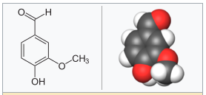
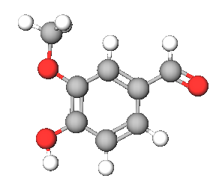
One molecule, three functions: One Smell Receptor
Vanillin
An extract of the cured, full-grown, unripe fruit of an orchid produces a popular flavoring. The natural extract sells for ~ $1500/kg versus ~ $20/kg for the synthetic version. The structure of the compound that is responsible for the smell/flavor is shown to the right. The Guinness Book of World Records once listed this compound as having the lowest smell detection limit of all chemicals (2 x 10 ^{–11} g per 1,000 cm³ of air).
C₈H₈O₃
Bonus:
The space (volume) of the Oakland Coliseum Arena, aka Oracle Arena, is approximately 90,000,000 ft³. If 1.00g of the compound were released at center court, and was completely and evenly dispersed throughout the building, would you smell it sitting in sec. 204, row H, seat 121? Show your calculation. (1 ft³ = 0.0283 m³)
Notes:
Marcel Proust, was a French novelist, critic, and essayist best known for his monumental novel À la recherche du temps perdu (In Search of Lost Time; earlier rendered as Remembrance of Things Past), published in seven parts between 1913 and 1927. He is considered by critics and writers to be one of the most influential authors of the 20th century.[
1

Slide 26
Organic Molecular Jeopardy
Common Formulas & Drawings
Vanillin
C₈H₈O₃
One function, an alcohol, is circled. What are the other two functions?:
Aldehyde + Ketone
Carboxylic Acid + Ester
Ketone + Ether
Aldehyde + Ether
Carboxylic Acid + Aldehyde
Notes:
Methyl salicylate (oil of wintergreen or wintergreen oil) is an organic ester naturally produced by many species of plants, particularly wintergreens. It is also synthetically produced, used as a fragrance, in foods and beverages, and in liniments.
The compound methyl salicylate was first isolated (from the plant Gaultheria procumbens) in 1843 by the French chemist Auguste André Thomas Cahours (1813–1891), who identified it as an ester of salicylic acid and methanol.[4]
1

Slide 27
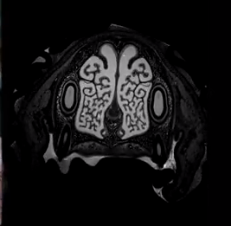
Inside the extraordinary nose of a search-and-rescue dog
https://www.youtube.com/watch?v=FLH36ML8IEU

Slide 28

Dogs Can Smell Cancer - Secret Life of Dogs - BBC
https://www.youtube.com/watch?v=e0UK6kkS0_M

Slide 29
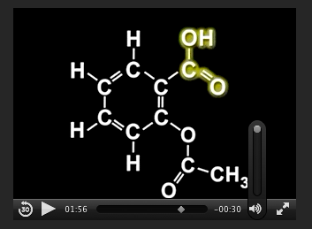
Synthesis of an NSAID
(Non-steroid anti-inflammatory drug)
Aspirin
C₉H₈O₄
http://chemconnections.org/general/movies/Representations.MOV
NSAIDs are used primarily to treat inflammation, mild to moderate pain, and fever.
Notes:
Discipline-Based Education Research: Understanding and
Improving Learning in Undergraduate Science and Engineering
Susan R. Singer, Natalie R. Nielsen, and Heidi A. Schweingruber, Editors
ISBN 978-0-309-25411-3 | DOI 10.17226/13362 2012
Effective instruction involves a range of
approaches, including making lectures more interactive, having students
work in groups, and incorporating authentic problems and activities.
Students who go on to have successful careers in science or engineering
must be problem solvers, skilled in quantitative reasoning and modeling,
effective at communication and cross-disciplinary collaboration, and cognizant
of relationships between science and society (Brewer and Smith,
2011). Students who do not pursue these careers need to understand science
and engineering to serve in their roles as citizens, consumers, and leaders
of business and government who need to make wise science-informed
decisions in their personal and professional lives. Choosing healthcare for
one’s children, buying a car, voting about land-use regulations, or retrofitting
one’s house or business to be more earthquake-resistant are but a few
of the decisions that today’s undergraduates may face. Their decisions on
these and other issues will be based, in part, on their confidence in the
methods of science and engineering and their understanding of the findings
of science and engineering.
The importance of science and engineering in preparing the technical
workforce and a science-literate citizenry has drawn increased attention to
the quality of undergraduate science and engineering education and how it
can be improved. There are persistent concerns that undergraduate science
and engineering courses are not providing students with high-quality learning
experiences, nor are they attracting and retaining students in science
and engineering fields (President’s Council of Advisors on Science and Technology,
2012). Colleges and universities also face the challenge of serving
an increasingly socially, economically, and ethnically diverse undergraduate
population entering college classrooms directly from high school, after a
military career or other life experiences, or from postsecondary educational
experiences at another institution. Sustained attention to motivating, engaging
and supporting the learning of all students who enter college science
and engineering classrooms is an imperative.

Slide 30

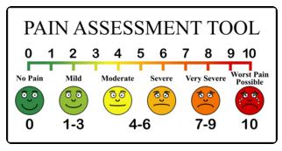
Synthesis of Aspirin
(an NSAID)
Aspirin & Pain
Used primarily to treat inflammation, mild to moderate pain, and fever.
Notes:
Discipline-Based Education Research: Understanding and
Improving Learning in Undergraduate Science and Engineering
Susan R. Singer, Natalie R. Nielsen, and Heidi A. Schweingruber, Editors
ISBN 978-0-309-25411-3 | DOI 10.17226/13362 2012
Effective instruction involves a range of
approaches, including making lectures more interactive, having students
work in groups, and incorporating authentic problems and activities.
Students who go on to have successful careers in science or engineering
must be problem solvers, skilled in quantitative reasoning and modeling,
effective at communication and cross-disciplinary collaboration, and cognizant
of relationships between science and society (Brewer and Smith,
2011). Students who do not pursue these careers need to understand science
and engineering to serve in their roles as citizens, consumers, and leaders
of business and government who need to make wise science-informed
decisions in their personal and professional lives. Choosing healthcare for
one’s children, buying a car, voting about land-use regulations, or retrofitting
one’s house or business to be more earthquake-resistant are but a few
of the decisions that today’s undergraduates may face. Their decisions on
these and other issues will be based, in part, on their confidence in the
methods of science and engineering and their understanding of the findings
of science and engineering.
The importance of science and engineering in preparing the technical
workforce and a science-literate citizenry has drawn increased attention to
the quality of undergraduate science and engineering education and how it
can be improved. There are persistent concerns that undergraduate science
and engineering courses are not providing students with high-quality learning
experiences, nor are they attracting and retaining students in science
and engineering fields (President’s Council of Advisors on Science and Technology,
2012). Colleges and universities also face the challenge of serving
an increasingly socially, economically, and ethnically diverse undergraduate
population entering college classrooms directly from high school, after a
military career or other life experiences, or from postsecondary educational
experiences at another institution. Sustained attention to motivating, engaging
and supporting the learning of all students who enter college science
and engineering classrooms is an imperative.

Slide 31
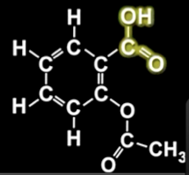
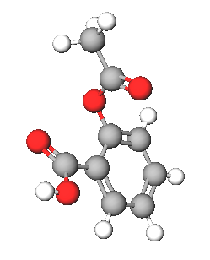
Organic Molecular Jeopardy
Common Formulas & Drawings
C₉H₈O₄
One of aspirin’s two functions is highlighted in yellow, the other is circled. What are the two functions?
Highlight=Alcohol; Circled=Ester
Highlight=Aldehyde; Circled=Ether
Highlight=Ketone; Circled=Alcohol
Highlight=Aldehyde; Circled=Ether
Highlight=Carboxylic Acid; Circled=Ester
Notes:
Methyl salicylate (oil of wintergreen or wintergreen oil) is an organic ester naturally produced by many species of plants, particularly wintergreens. It is also synthetically produced, used as a fragrance, in foods and beverages, and in liniments.
The compound methyl salicylate was first isolated (from the plant Gaultheria procumbens) in 1843 by the French chemist Auguste André Thomas Cahours (1813–1891), who identified it as an ester of salicylic acid and methanol.[4]
1

Slide 32
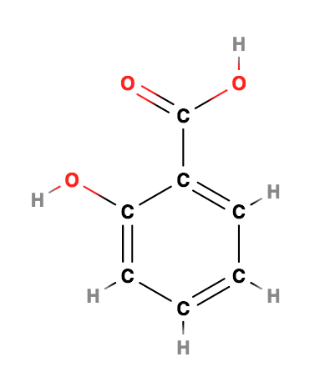
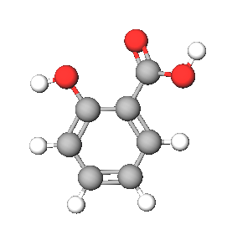
Organic Molecular Jeopardy
FINAL JEOPARDY QUESTION
C₇H₆O₃
One of the reactants used to produce aspirin is shown above. It also has two functions: one is highlighted in yellow, the other is circled. What are the two functions?
Highlight=Alcohol; Circled=Ester
Highlight=Carboxylic Acid; Circled=Alcohol
Highlight=Ketone; Circled=Alcohol
Highlight=Aldehyde; Circled=Ether
Highlight=Carboxylic Acid; Circled=Ester
Notes:
Methyl salicylate (oil of wintergreen or wintergreen oil) is an organic ester naturally produced by many species of plants, particularly wintergreens. It is also synthetically produced, used as a fragrance, in foods and beverages, and in liniments.
The compound methyl salicylate was first isolated (from the plant Gaultheria procumbens) in 1843 by the French chemist Auguste André Thomas Cahours (1813–1891), who identified it as an ester of salicylic acid and methanol.[4]
1

Slide 33
Organic Molecular Jeopardy
Tabulation
Organic Molecular Jeopardy
 | TEAMS:
QUESTION | A | B | C | D | E
1
2
3
4
5
6
7
FINAL
TOTAL
A word from our sponsor:
https://www.youtube.com/watch?v=hfe5xQ1M7Jw

Slide 34

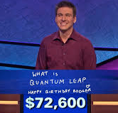
Jeopardy
Winners
May 3, 2019
James Holzhauer, 22 days, $1,691,008
Notes:
Methyl salicylate (oil of wintergreen or wintergreen oil) is an organic ester naturally produced by many species of plants, particularly wintergreens. It is also synthetically produced, used as a fragrance, in foods and beverages, and in liniments.
The compound methyl salicylate was first isolated (from the plant Gaultheria procumbens) in 1843 by the French chemist Auguste André Thomas Cahours (1813–1891), who identified it as an ester of salicylic acid and methanol.[4]
1

Slide 35
Organic Molecular Jeopardy
Winners
Organic Molecular Jeopardy
 | TEAMS:
QUESTION | A | B | C | D | E
1
2
3
4
5
6
7
FINAL
TOTAL
Notes:
Methyl salicylate (oil of wintergreen or wintergreen oil) is an organic ester naturally produced by many species of plants, particularly wintergreens. It is also synthetically produced, used as a fragrance, in foods and beverages, and in liniments.
The compound methyl salicylate was first isolated (from the plant Gaultheria procumbens) in 1843 by the French chemist Auguste André Thomas Cahours (1813–1891), who identified it as an ester of salicylic acid and methanol.[4]
1

Slide 36
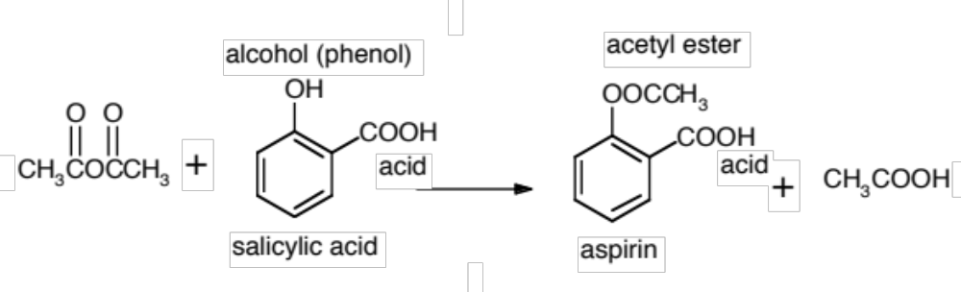
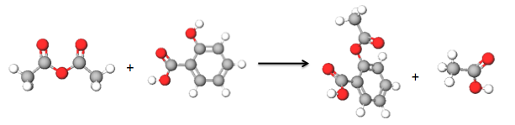
Synthesis of Aspirin
Select Partner(s): form a group of 2-3.
acetic anhydride
H₃PO₄
acetic acid

Slide 37
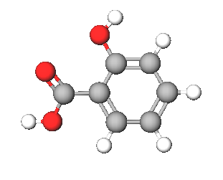
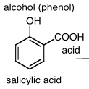
REACTANT: Salicylic Acid
Common Functional Groups
Name General Formula
Alcohols R−ΟΗ
Ethers R−Ο−R′
Amines R−ΝΗ₂
Carboxylic Acids

Slide 38
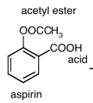
PRODUCT: Acetyl salicylic acid (aspirin)
Common Functional Groups
Name General Formula
Aldehydes
Ketones
Carboxylic Acids
Esters
Amides

Slide 39
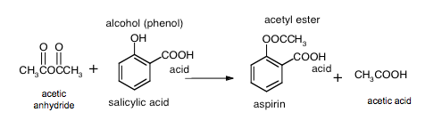
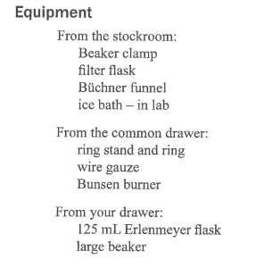
Synthesis of Aspirin
H₃PO₄
Get equipment from stockroom with your group.
Follow instructions in lab manual carefully. Be mindful of your safety. WEAR eye protection.
Store in lab drawer as instructed in Part A.3 of the instructions of the lab procedure.

Slide 40
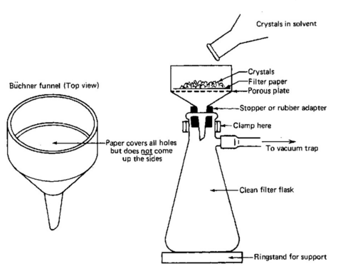
Vacuum Filtration
Store aspirin in lab drawer as instructed in Part A.3 of the instructions of the lab procedure.
https://www.youtube.com/watch?v=uJO_frXdNsU

Slide 41
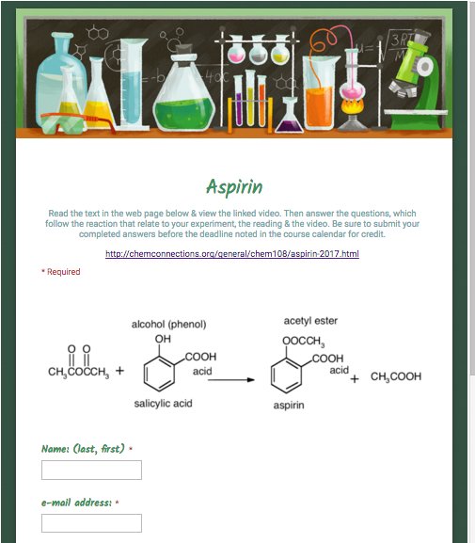
Completed Report Form & On-line Post Lab
Due next week.
http://chemconnections.org/general/chem108/Aspirin%20Guide.html
Store filtered crude aspirin in lab drawer and weigh next week.
NEXT WEEK:
Calculate % Yield.

Slide 42
TODAY:
Calculate Theoretical Yield
H₃PO₄
SA
A
grams (Salicylic Acid)
grams (Aspirin)
Using Mass of
salicylic acid
from page 90.
Moles
Molar Mass
C₉H₈O₄
MW = 180.15
Stoichiometry
grams (A)
(Molecular
? grams (SA)
1 mol (SA)
1 mol A
Weight A)
???
aspirin
? (A)
1 mol SA
grams (SA)
1 mol (A)
(Molecular
Weight SA)
"Gatekeeper"
C₇H₆O₃
MW = 138.12

Slide 43
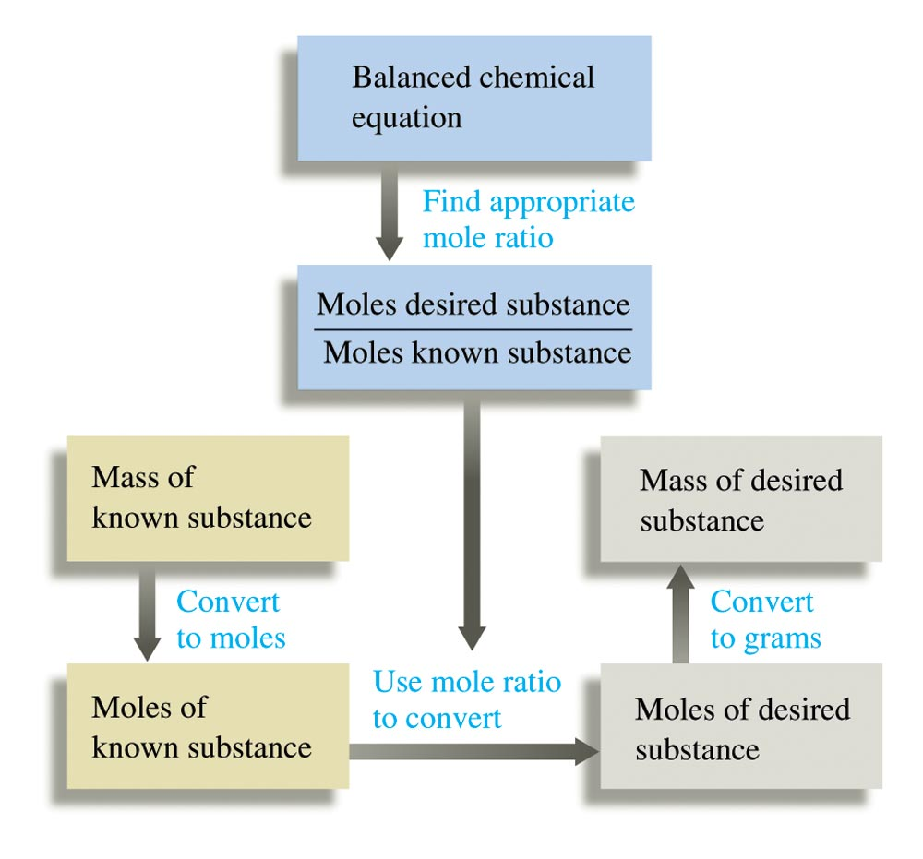
Mass Calculations:
Reactants Products

Slide 44
Example
H₃PO₄
SA
A
grams (Salicylic Acid)
grams (Aspirin)
Moles
Molar Mass
C₉H₈O₄
MW = 180.15
Stoichiometry
grams (A)
(Molecular
5.0 grams (SA)
1 mol (SA)
1 mol A
Weight A)
6.5 g
aspirin
? (A)
1 mol SA
grams (SA)
1 mol (A)
(Molecular
Weight SA)
"Gatekeeper"
C₇H₆O₃
MW = 138.12

Slide 45
TODAY:
Calculate Theoretical Yield
H₃PO₄
SA
A
grams (Salicylic Acid)
grams (Aspirin)
Using your mass of
salicylic acid
from page 90.
Moles
Molar Mass
C₉H₈O₄
MW = 180.15
Stoichiometry
grams (A)
(Molecular
? grams (SA)
1 mol (SA)
1 mol A
Weight A)
???
aspirin
? (A)
1 mol SA
grams (SA)
1 mol (A)
(Molecular
Show clearly labeled calculation with units & correct s.f ; Have pg. 90 signed before leaving lab.
Weight SA)
"Gatekeeper"
C₇H₆O₃
MW = 138.12

Slide 46

Percent Yield
In synthesis as in any experiment, it is very difficult and at most times impossible to be perfect. Therefore the actual yield (g) is measured and compared to the theoretical calculated yield (g). This is the percent yield:
% Yield = actual (g) / theoretical (g) x 100
This calculation is for next week.

